Slide 1
TSNE, Clustering Experimentation
By: Kiran Hedge, Tanishq Nimale

Slide 2
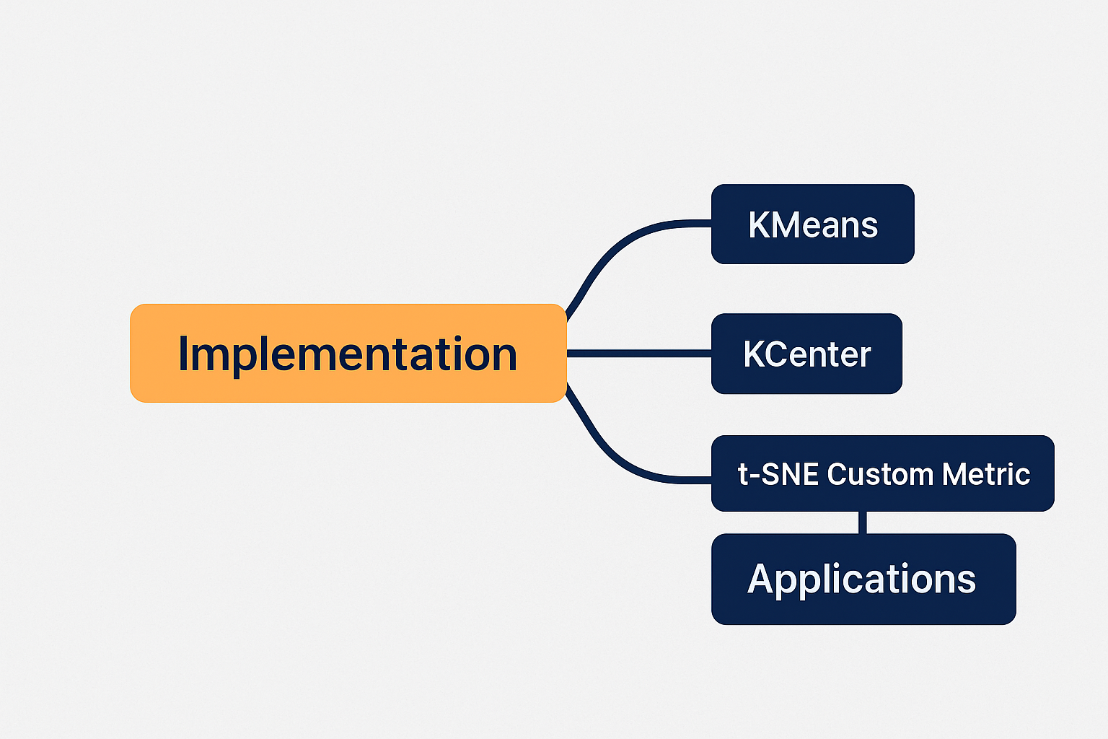

Slide 3
Background - Clustering

Slide 4
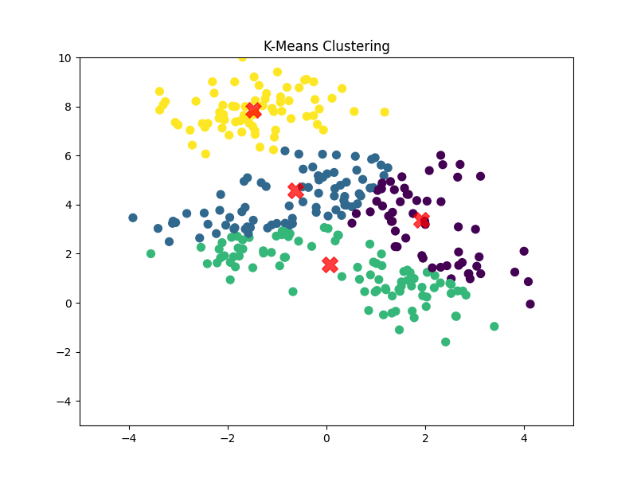
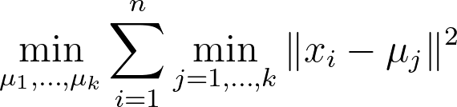
K - Means
Unsupervised Learning Algorithm
Lloyd’s Algorithm
Initialize: Randomly select k initial centroids (often data points).
Assign: Assign each point to the nearest centroid (Voronoi partitioning).
Update: Recompute centroids as the mean of all points in their cluster.
Repeat: Until centroids stabilize or max iterations
Objective: Minimize the sum of squared distances from points to their nearest center
Math:
Centers: Mean vectors (not necessarily data points).
Time Complexity: O(nkdT) where n: data points, k: clusters, d: Dimension, T : Iterations.
Cluster Shape: Assumes spherical, similarly sized clusters.
Outliers: Sensitive (outliers distort centroids).
Theoretical Guarantee: No approximation guarantees (local optima).
Best For: Spherical clusters, large datasets, Image Compression

Slide 5
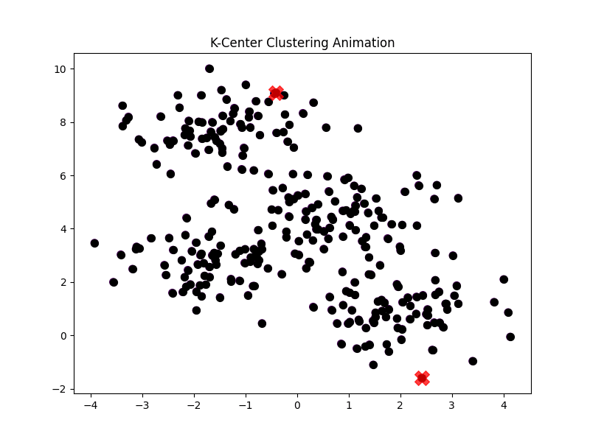
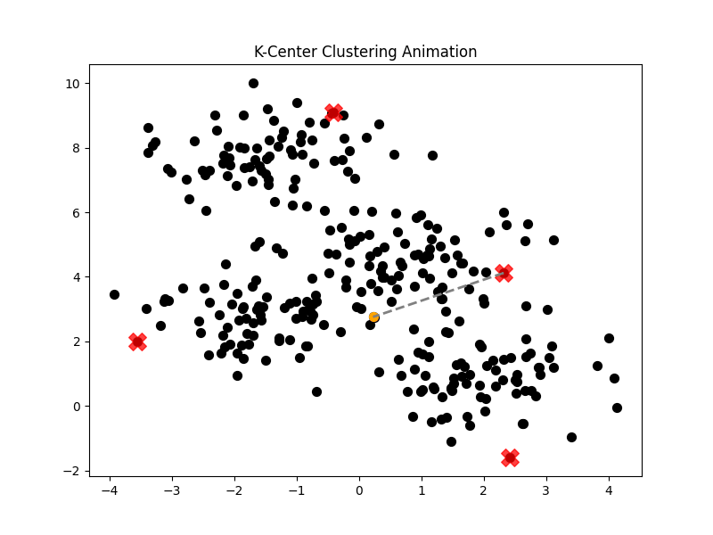
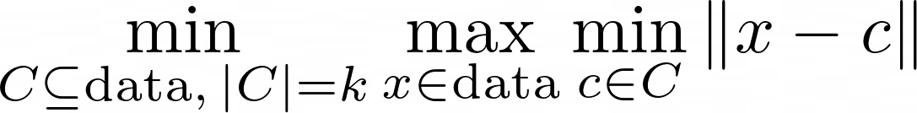
K - Center
Unsupervised Learning Algorithm
Greedy Algorithm
Initialize: Randomly select the first center c₁ from the data.
Iterate: For i = 2 to k:
Find the data point farthest from all existing centers.
Add this point as the next center c_{i}.
Assign: Assign each point to its nearest center.
Objective: Minimize the maximum distance from any data point to its nearest. center
Math:
Centers: Must be actual data points.
Time Complexity: O(kn) where n: data points, k: clusters.
Cluster Shape: No assumptions (works for non-convex shapes).
Outliers: Robust (minimizes maximum distance).
Theoretical Guarantee: 2-approximation algorithm (bounded suboptimal solution).
Best For: Outlier-aware tasks (fraud detection), small datasets, Facility Location.

Slide 6
Experimentation - Clustering

Slide 7
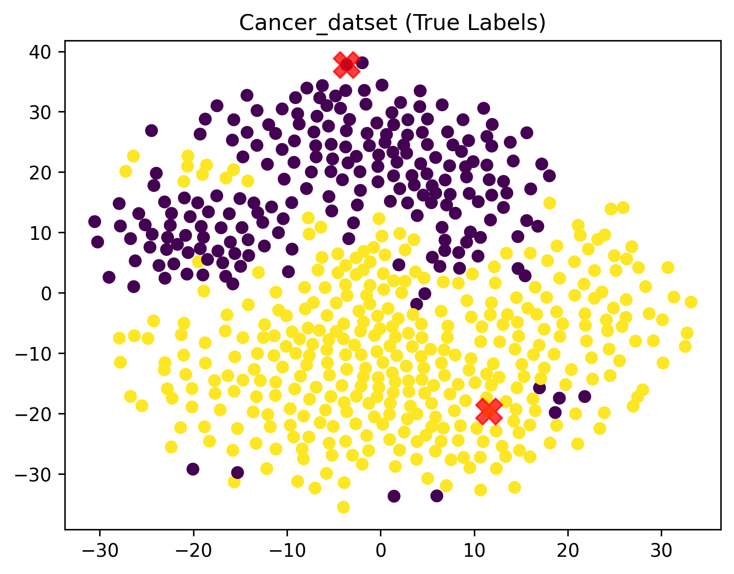
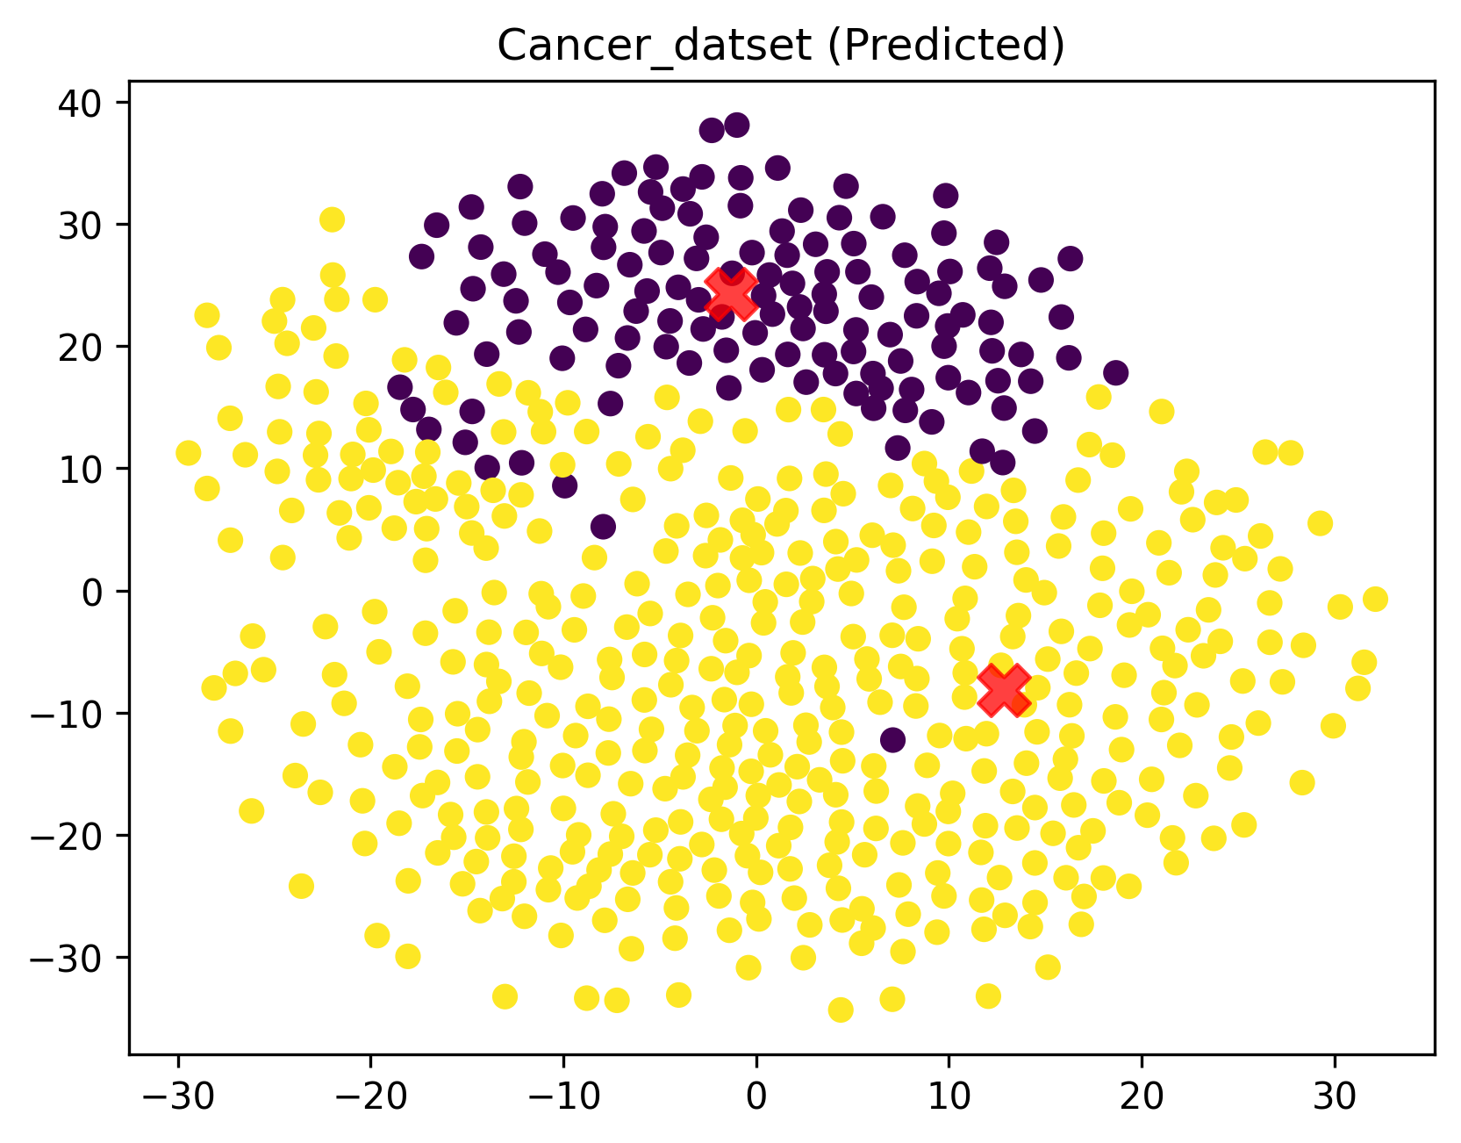
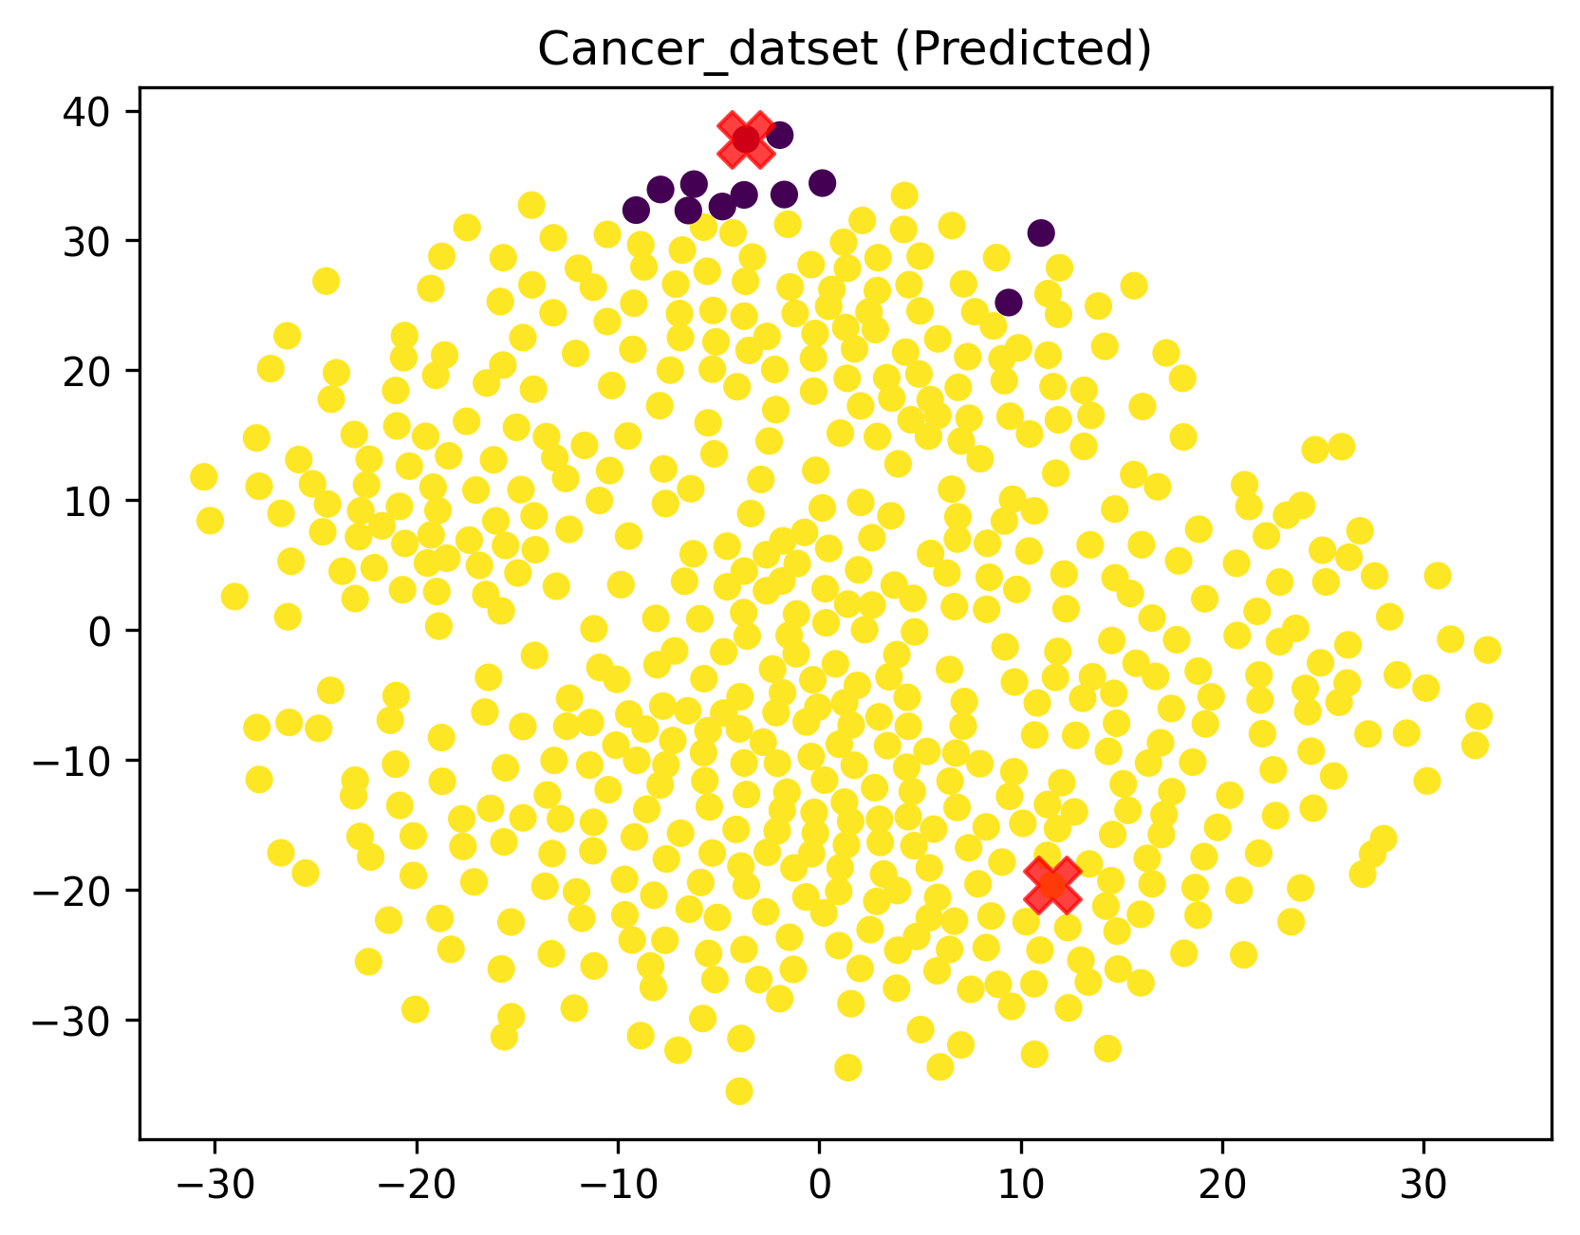
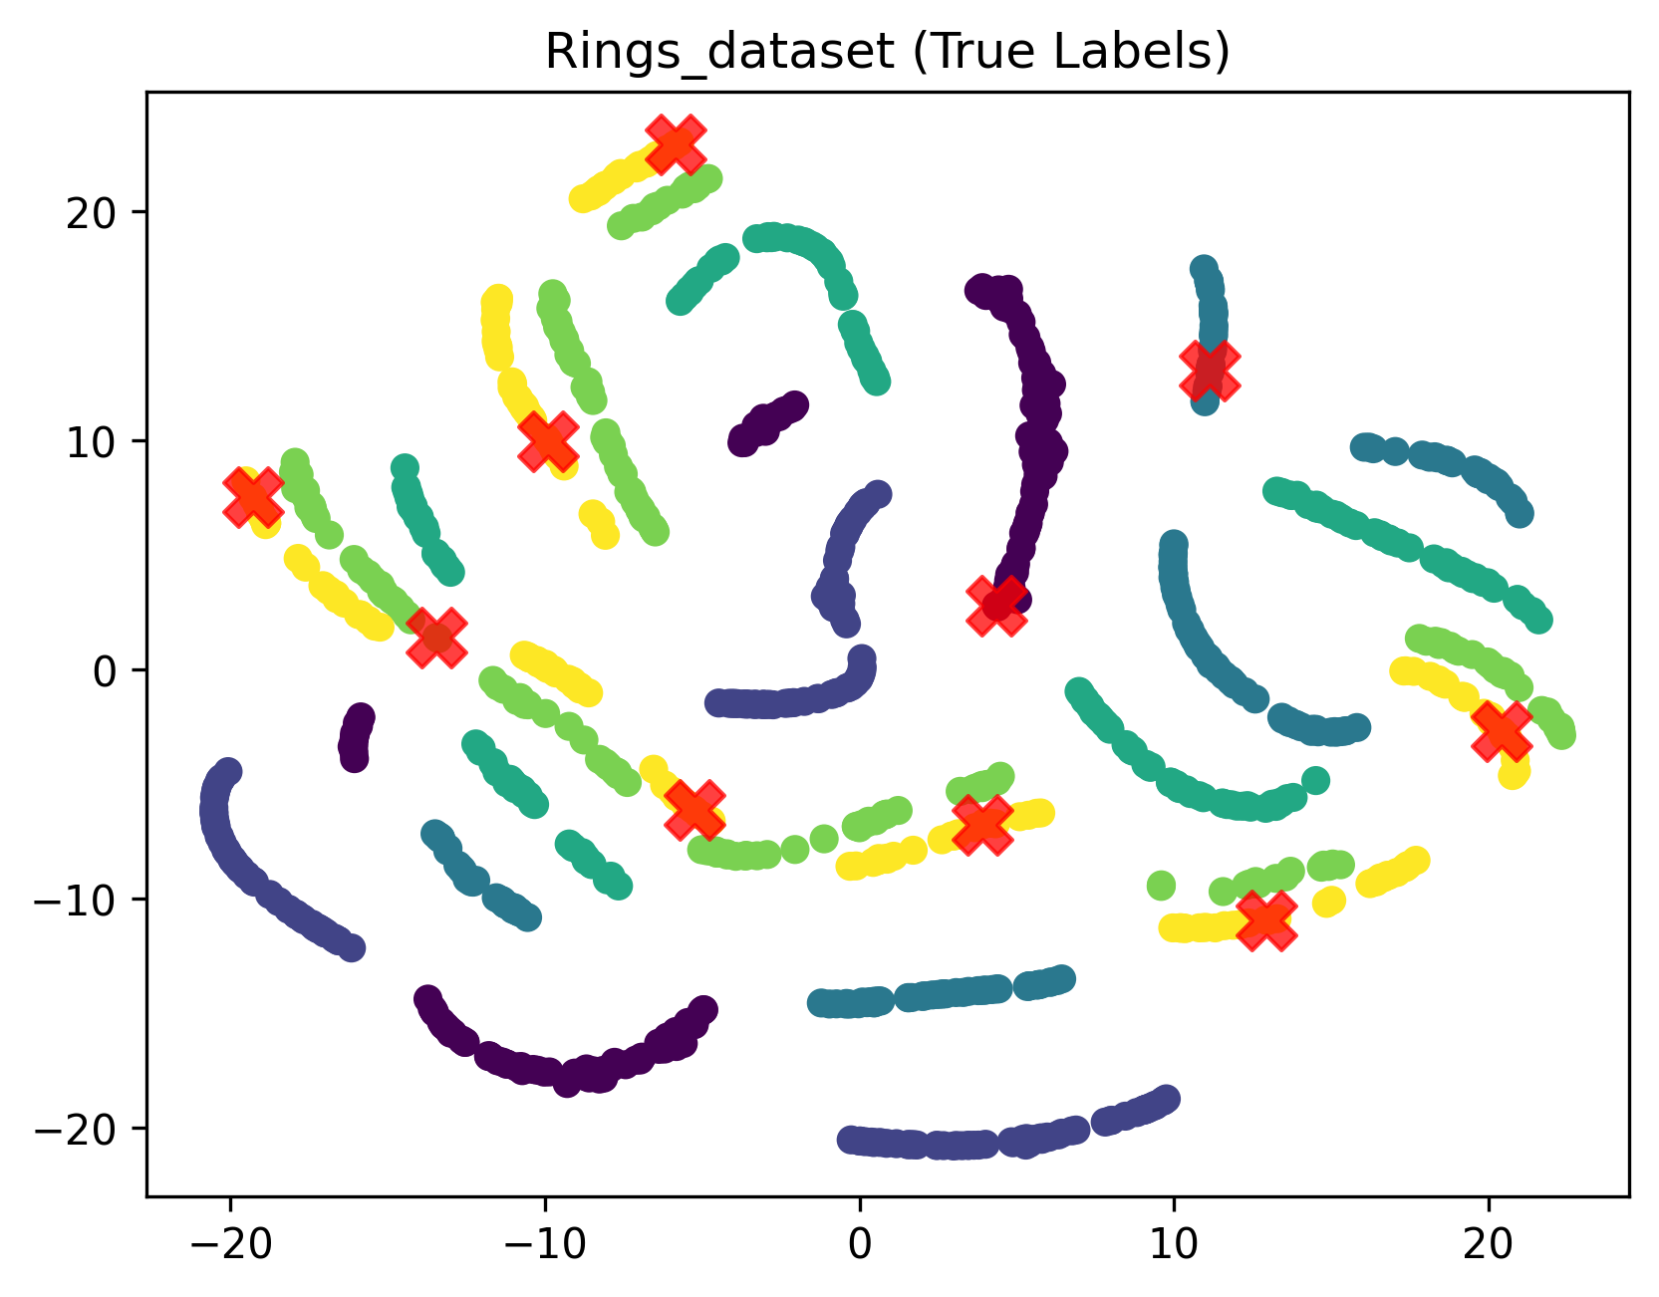
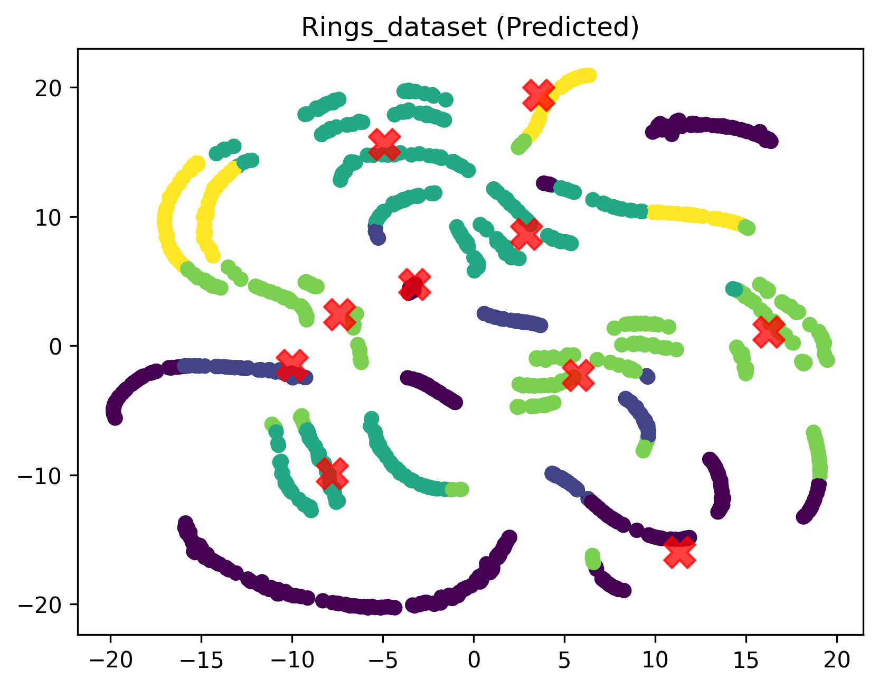
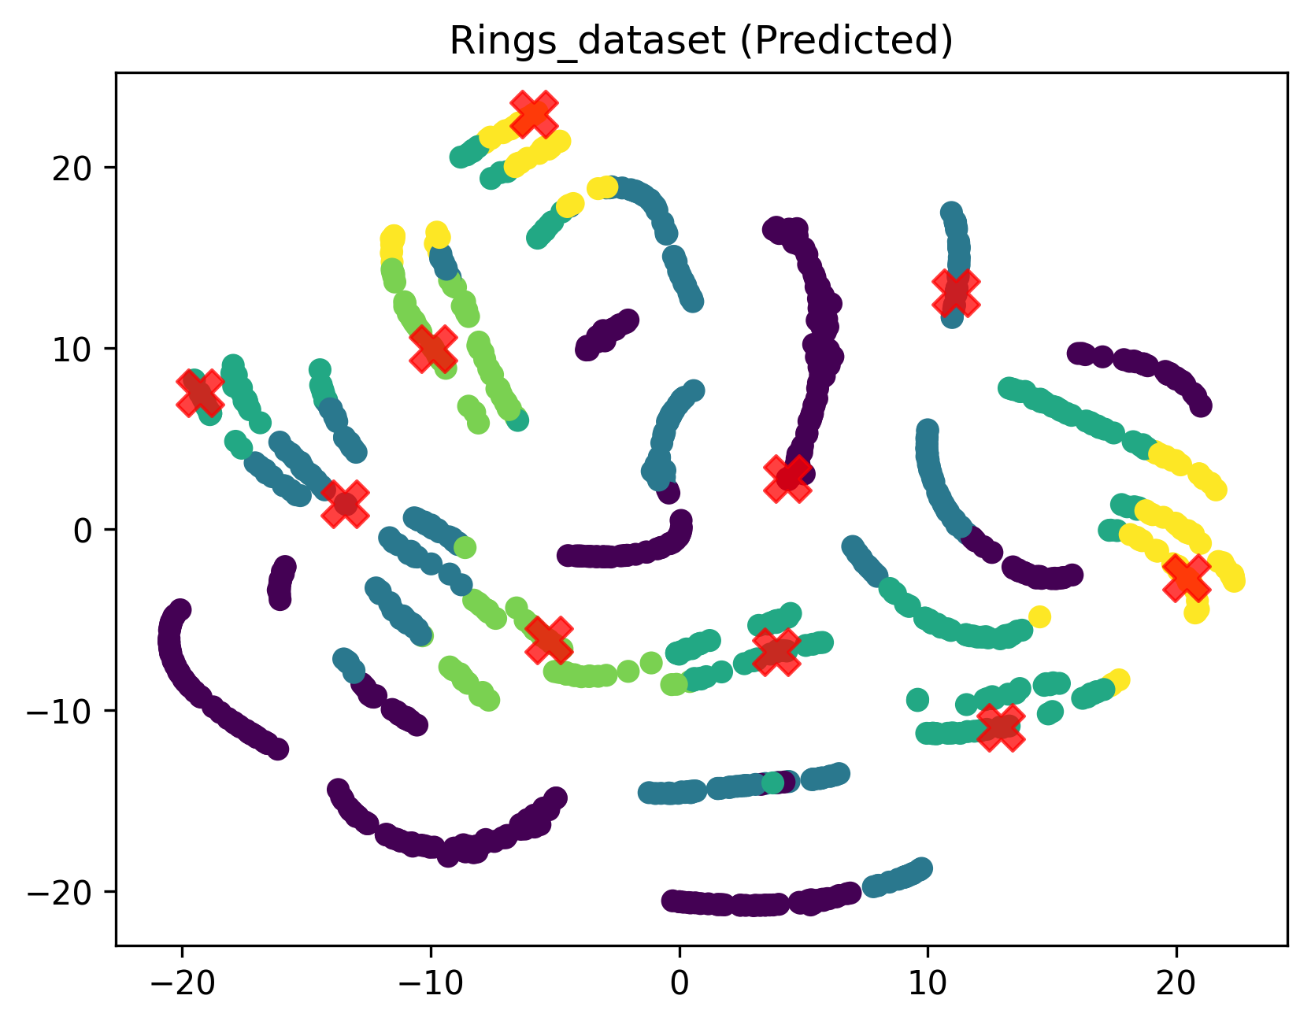
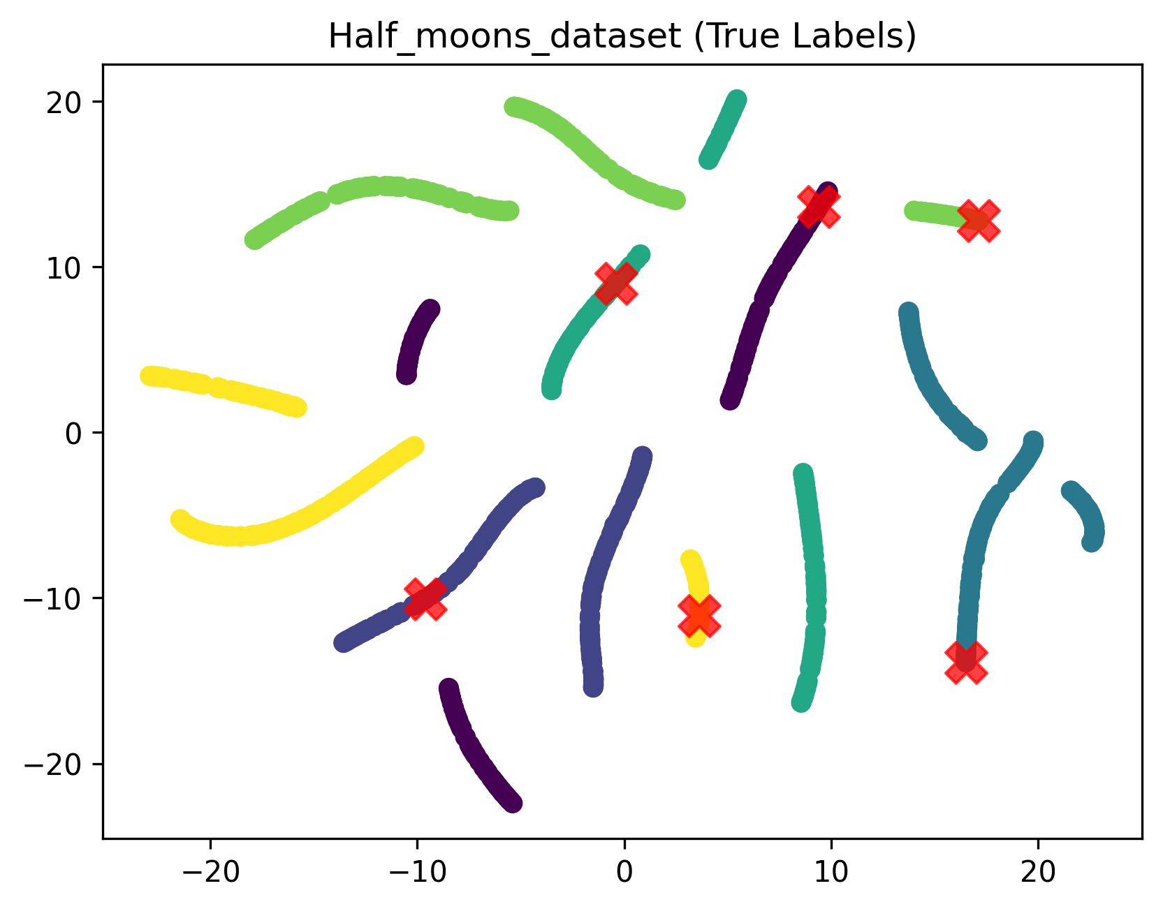
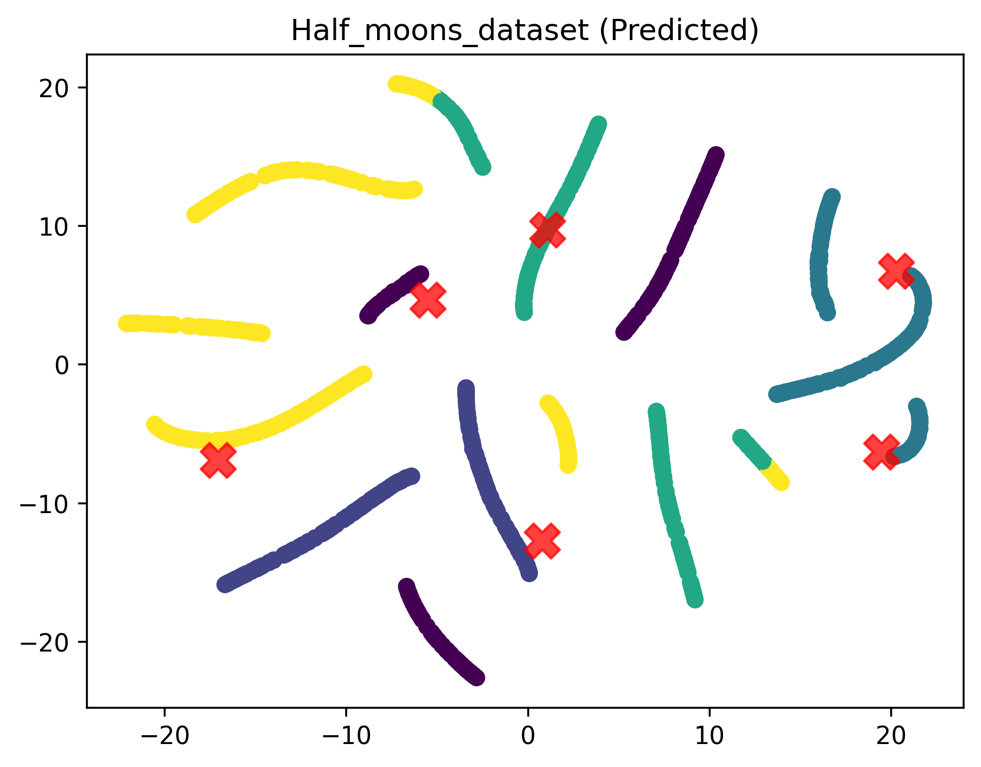
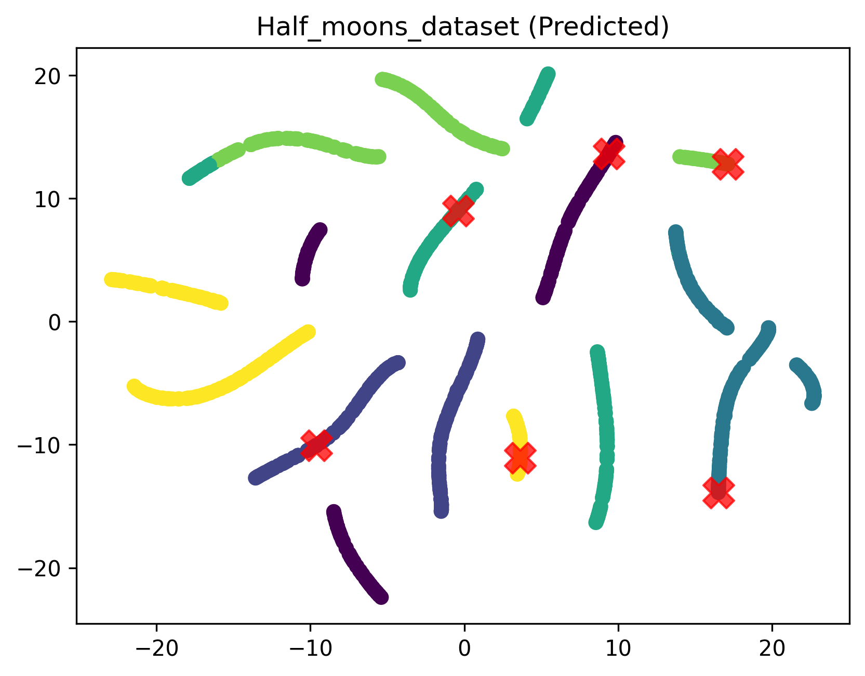
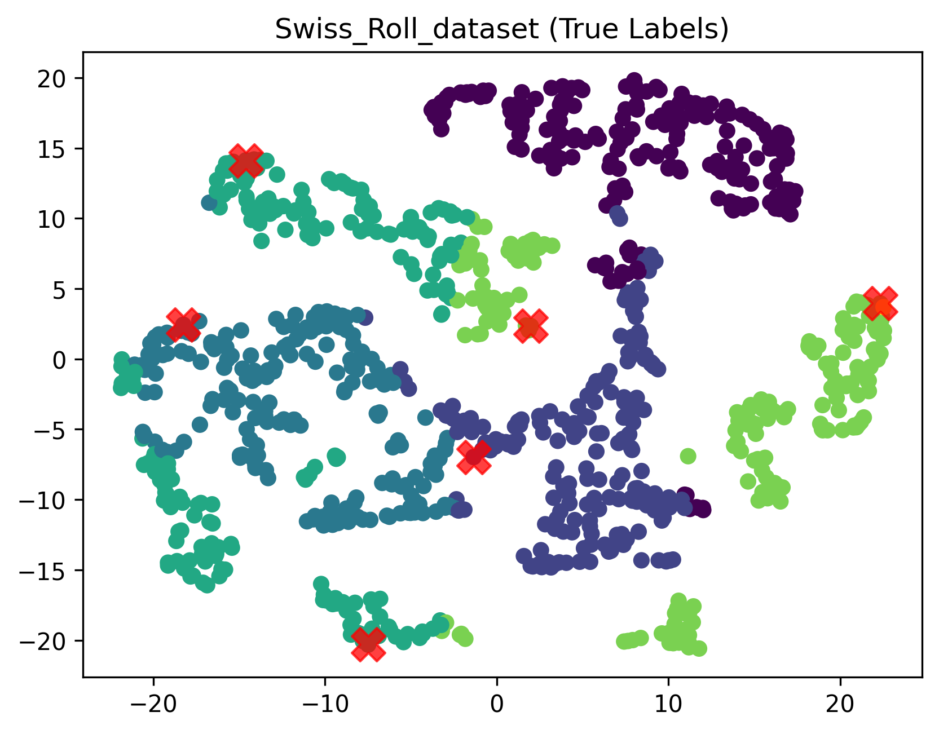
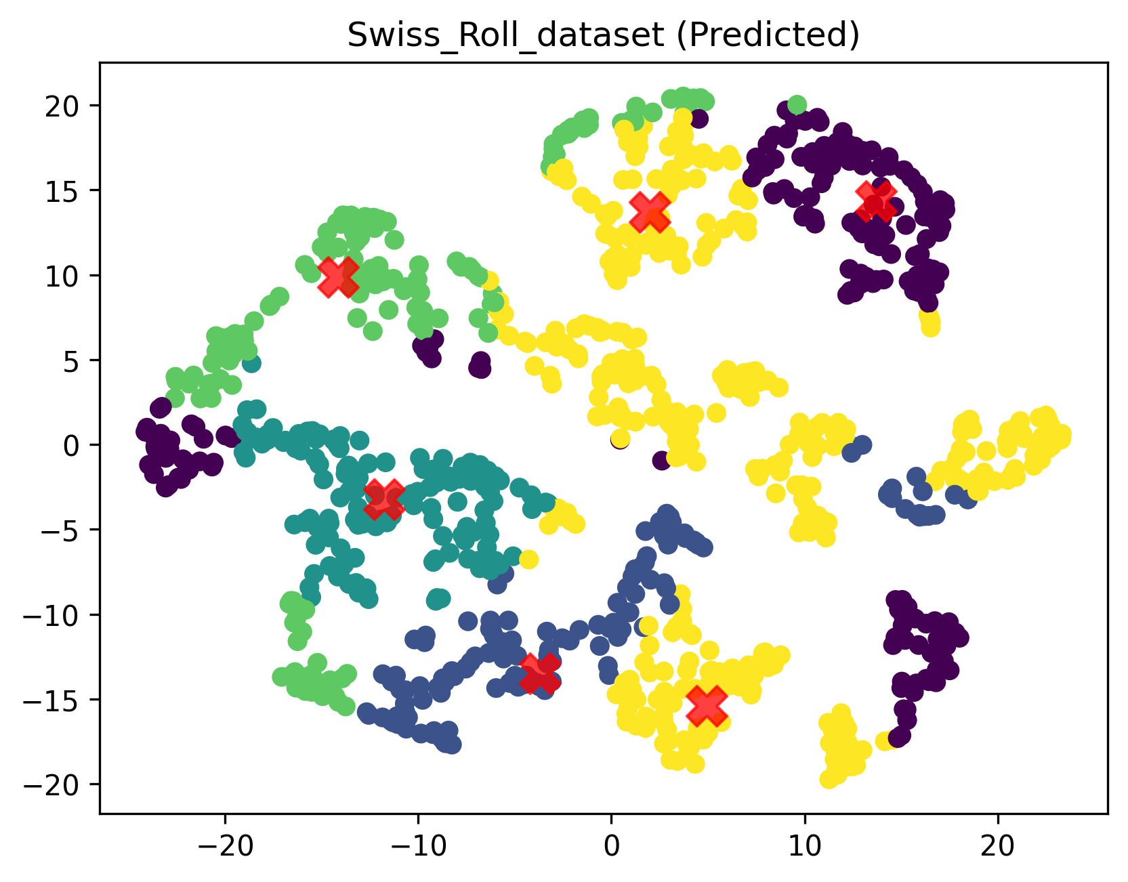
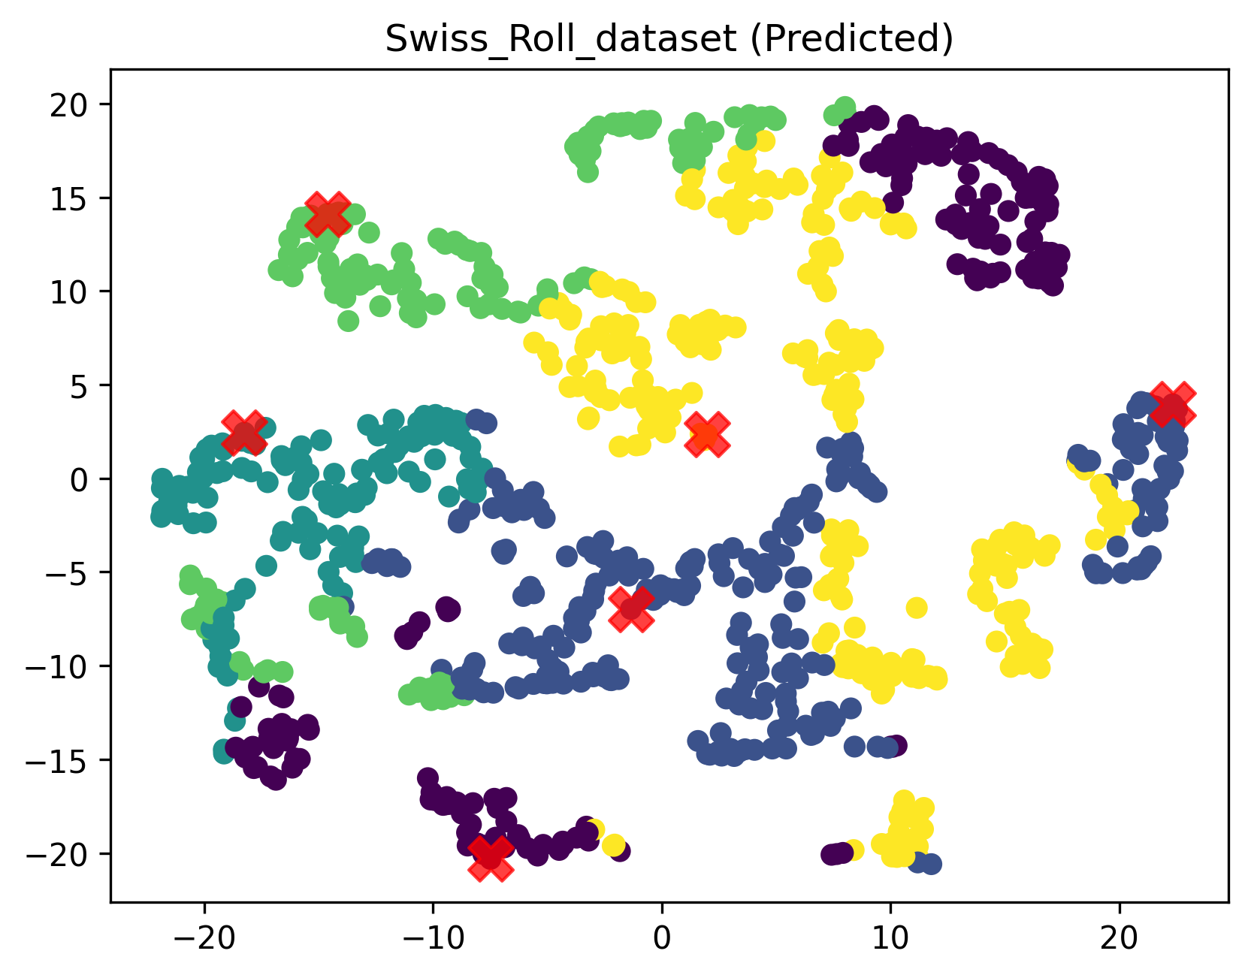
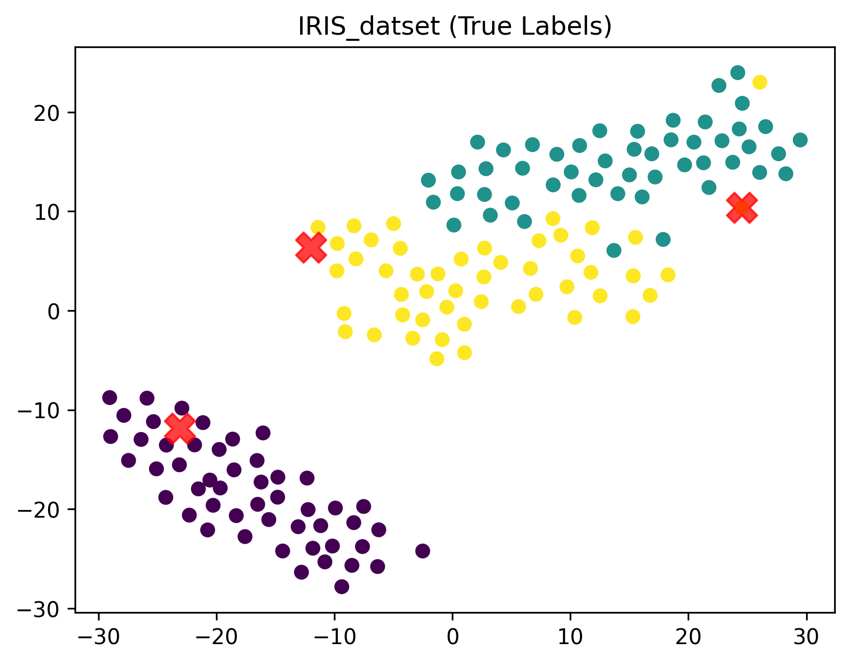
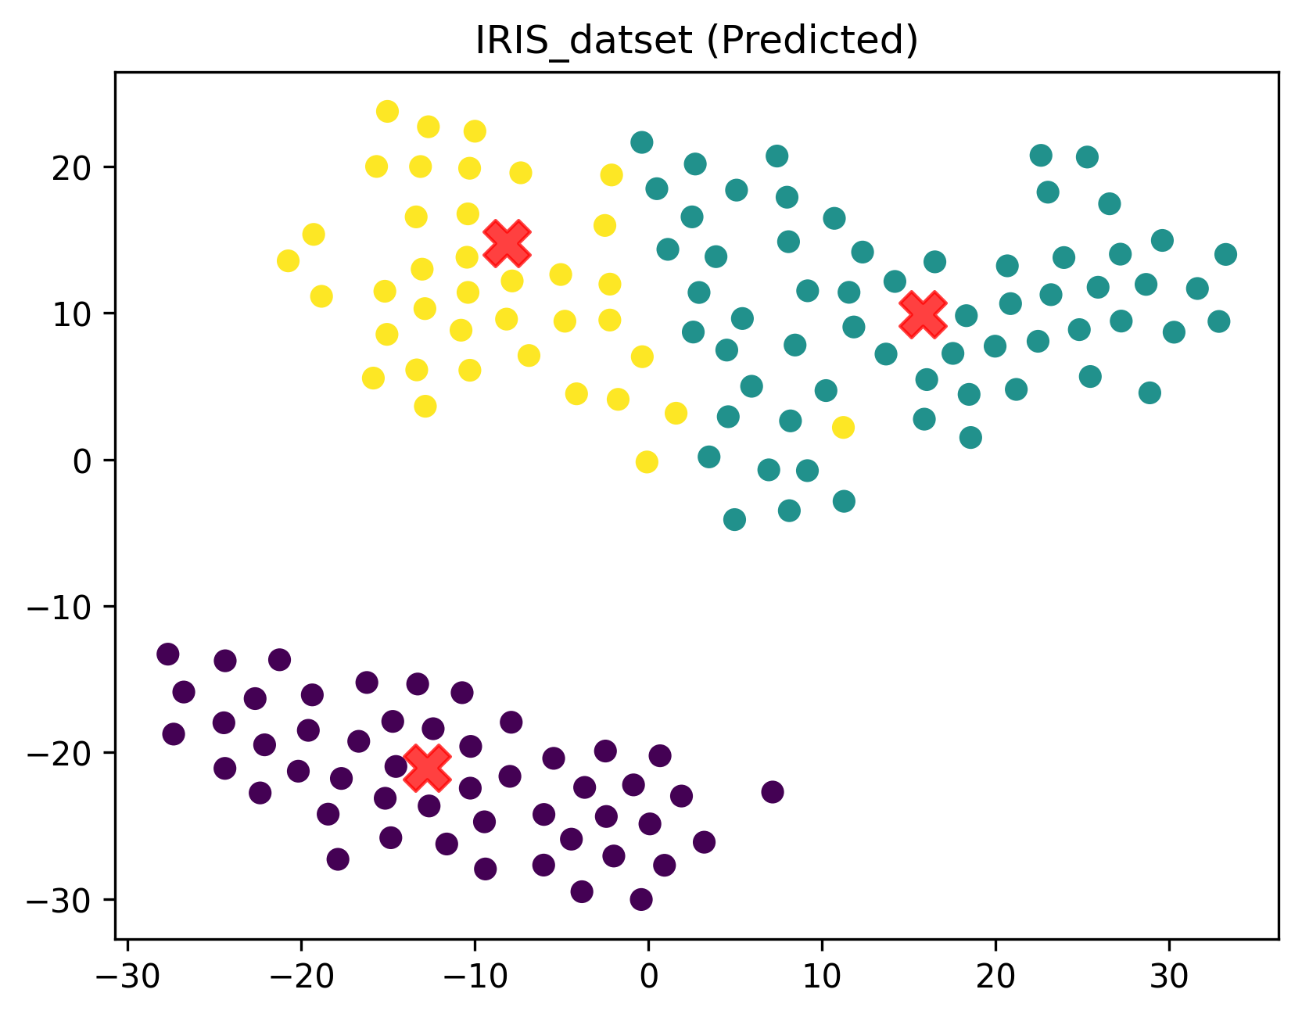
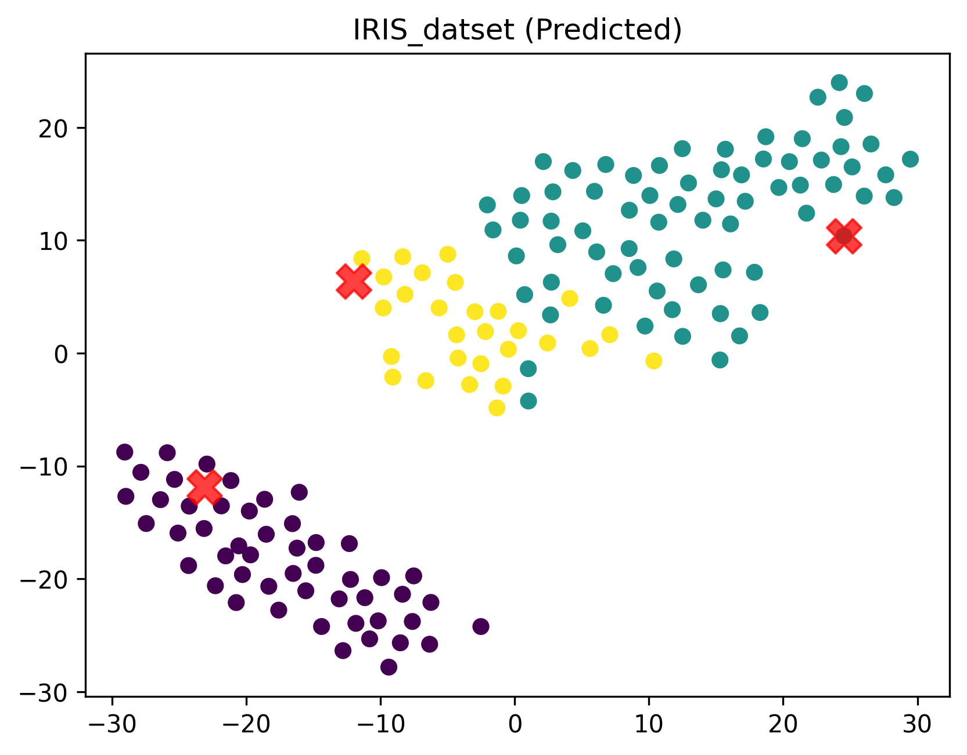
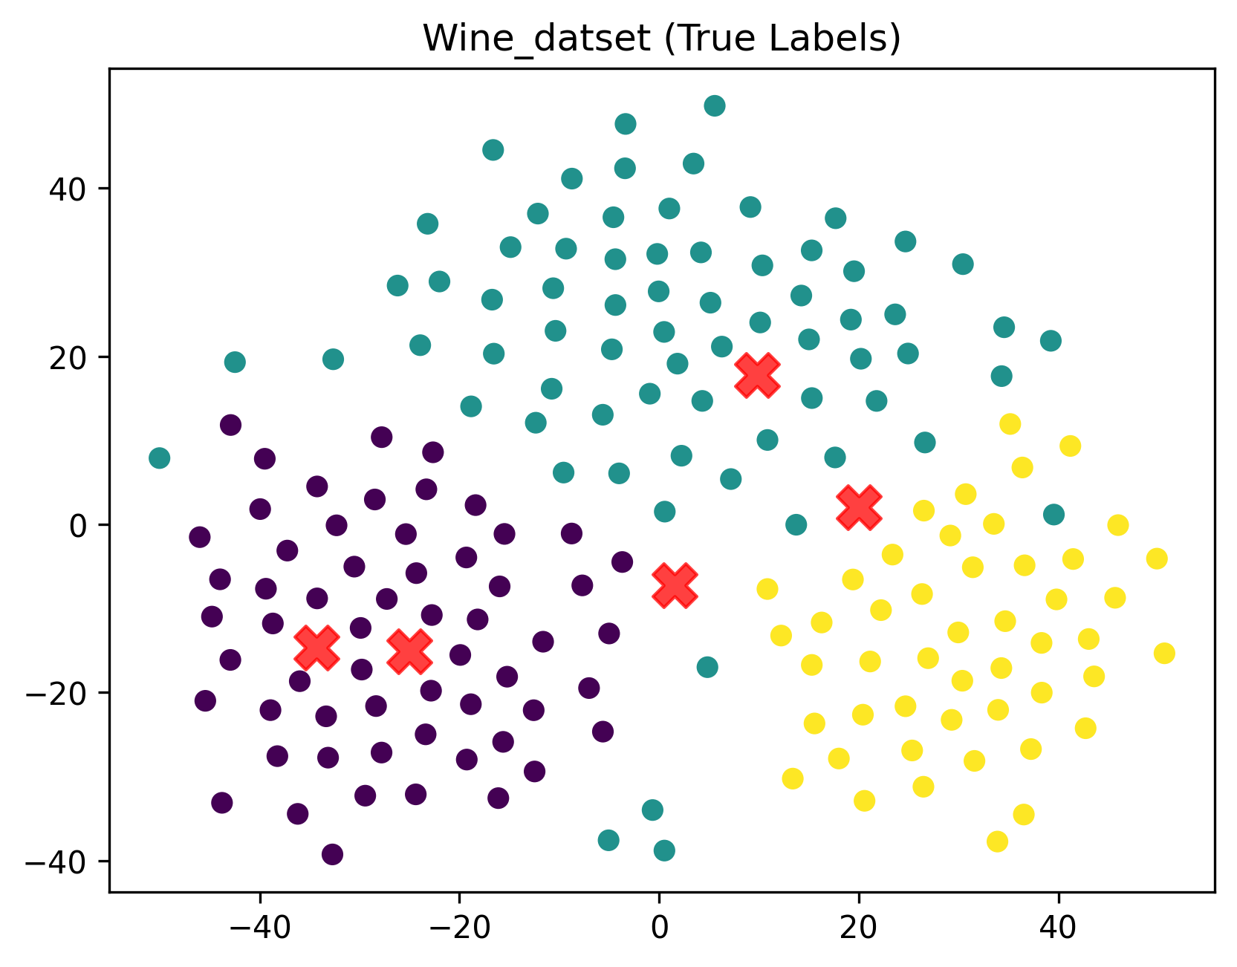
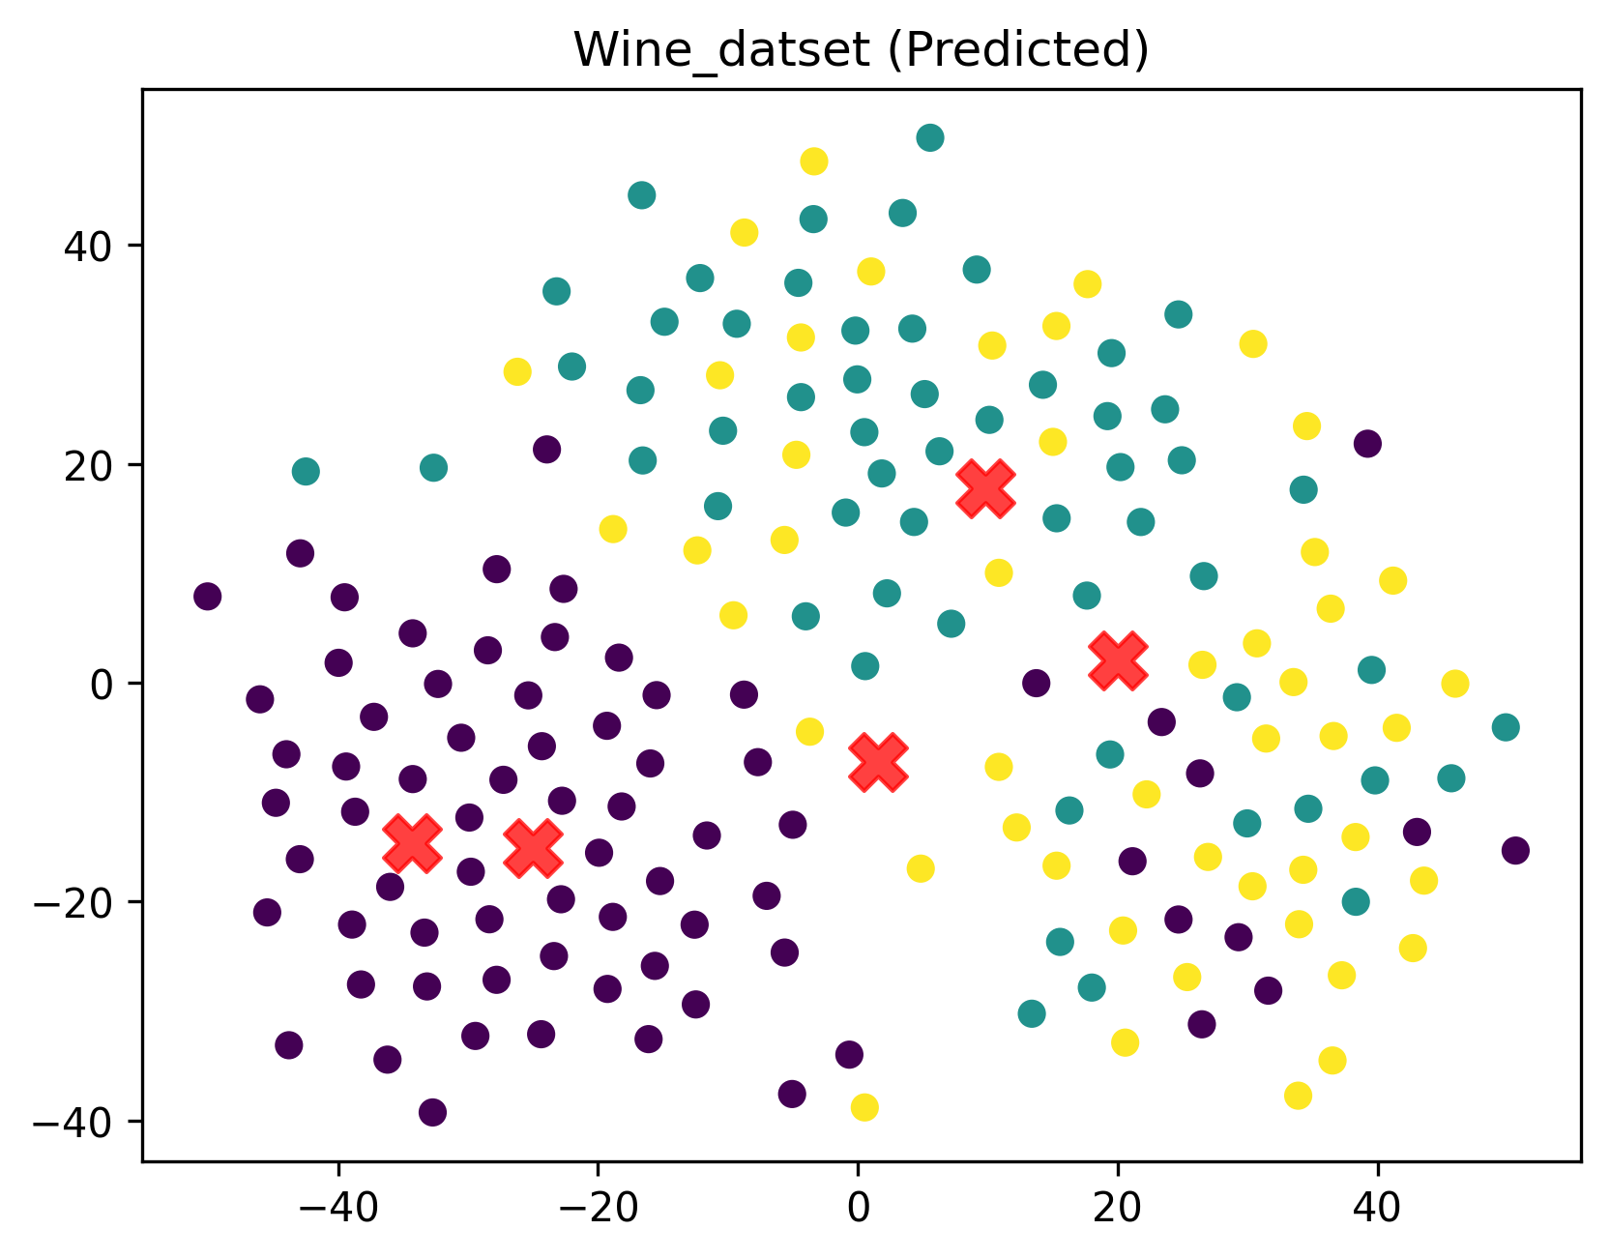
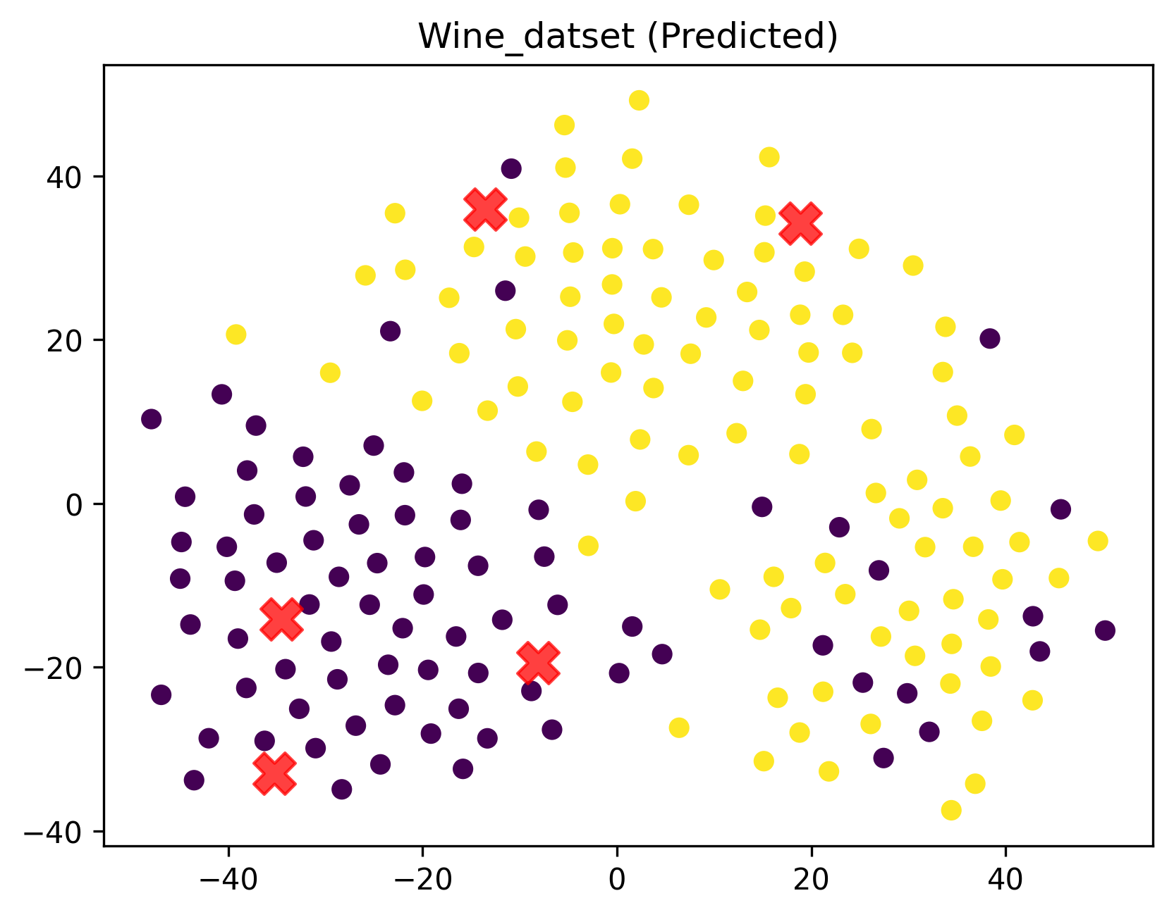
Actual/True Labels vs K - Means vs K - Center Standard Datasets

Slide 8
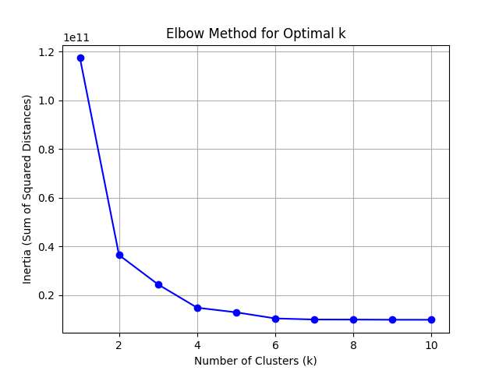
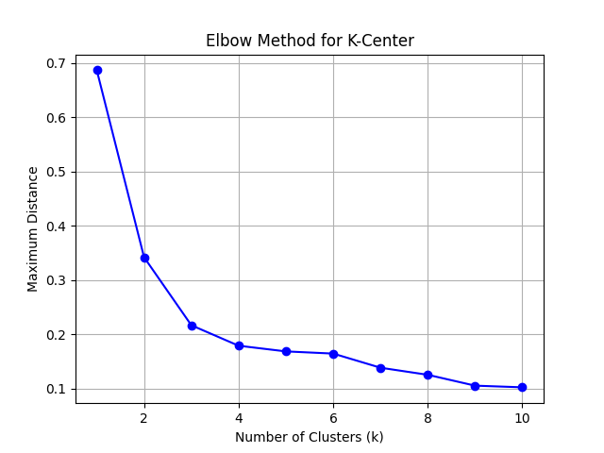
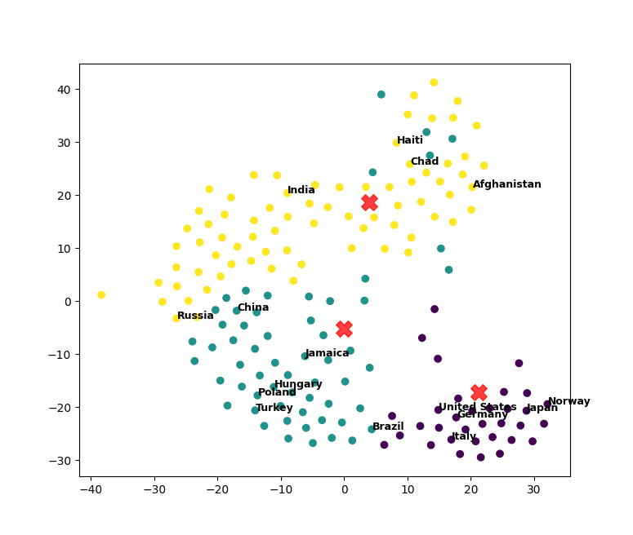
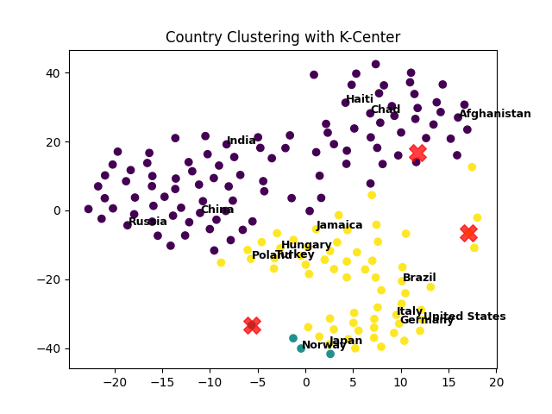
K - Means vs K - Center Data Exploration

Slide 9
Background - Visualization

Slide 10
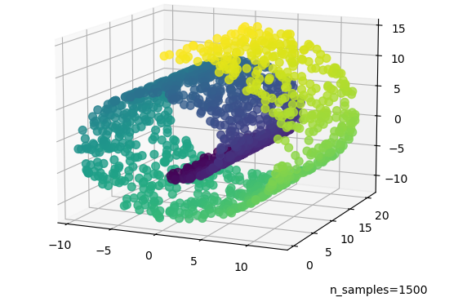

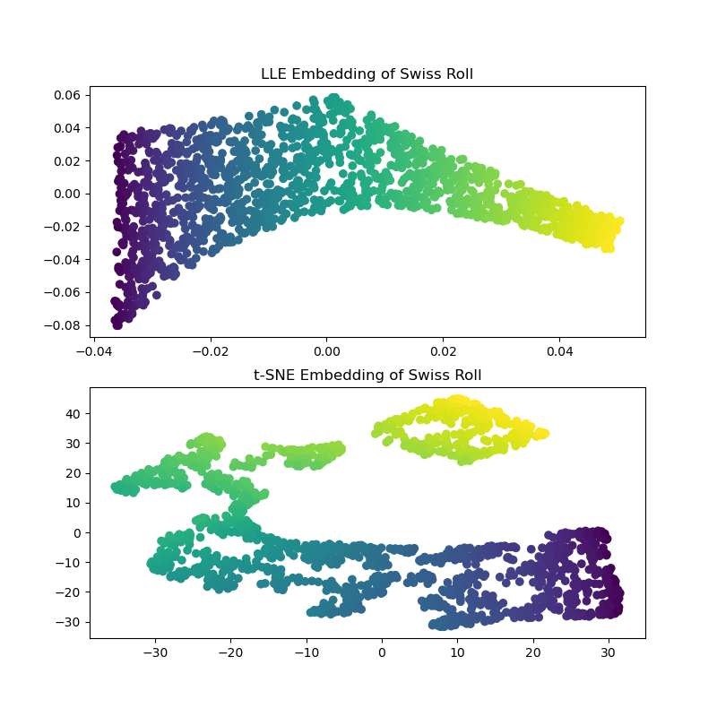
TSNE
(t-distributed stochastic neighbor embedding)
TSNE magic
It is a dimensionality-reduction technique.
Used to visualize high-dimensional data in 2D or 3D.
Preserves the local structure of data points.
Based on probabilistic similarity between points.

Slide 11
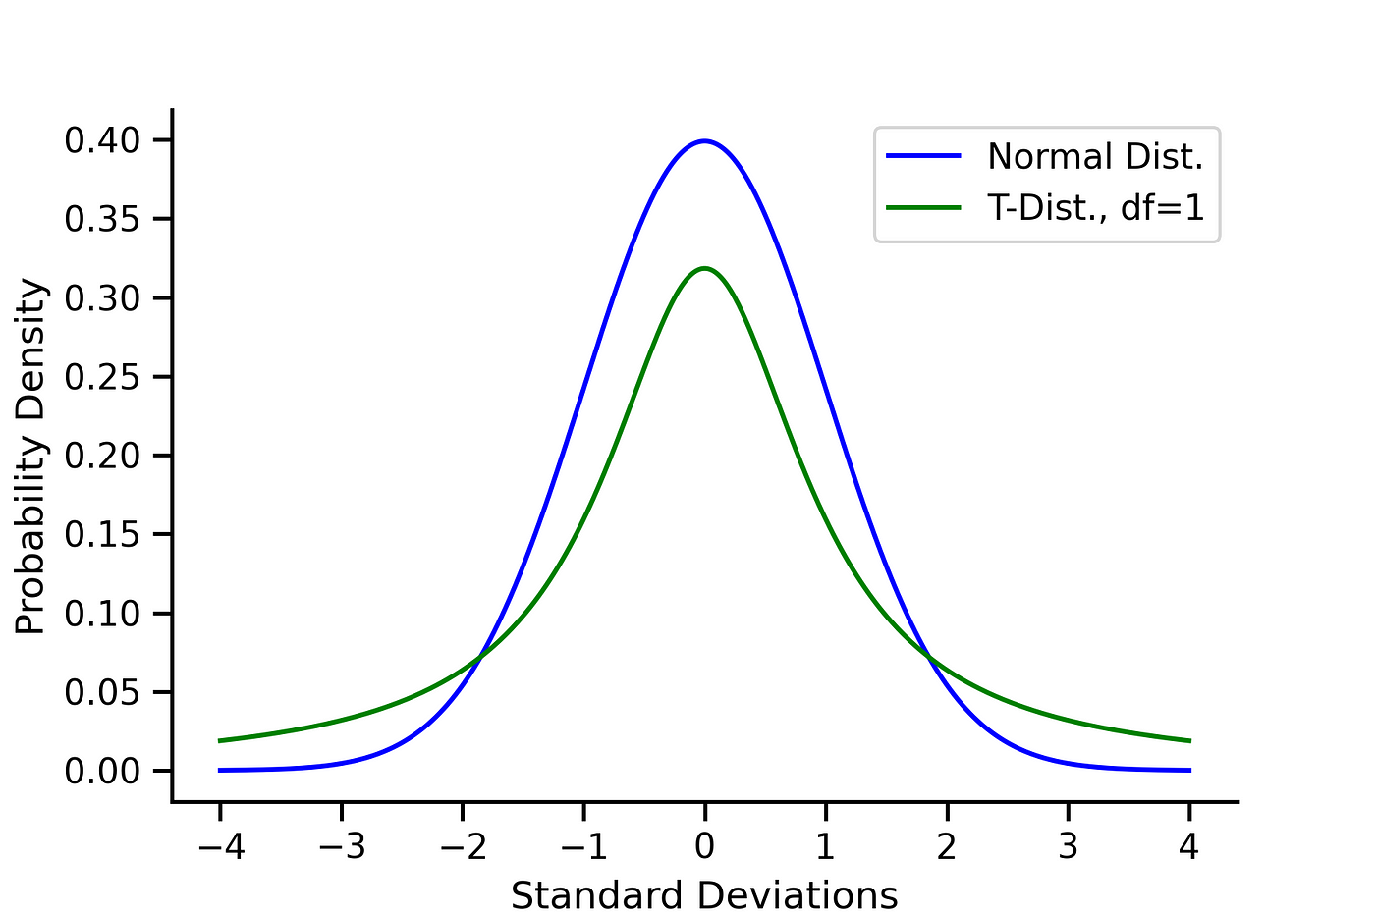
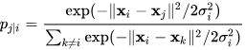
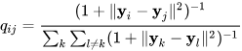
t-SNE Working: Similarity in Original & Transformed Space
Original Space (High Dimensionality):
P_ij represents the probability that point i is similar to point j.
Calculated using a Gaussian distribution:
Points that are closer in original space have high similarity.
Transformed Space (Low Dimensionality):
Q_ij represents the similarity of points in the low-dimensional space.
Calculated using a Student’s t-distribution:
Points that are closer in transformed space have high similarity.

Slide 12
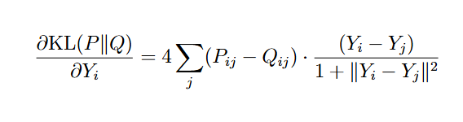
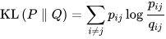
t-SNE Working: Learning and Parameters
Learning:
Learning is basically making Q_ij close to P_ij.
We use KL (Kullback-Leibler) dimension and minimize the KL divergence, by computing its gradient.
Perplexity:
A hyperparameter that controls the balance between local and global aspects of the data.

Slide 13
Experimentation - Visualization

Slide 14
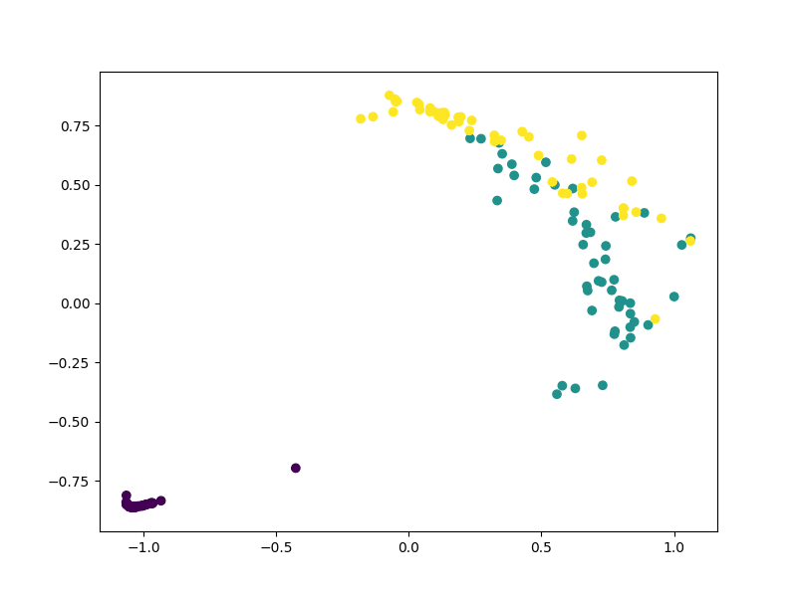
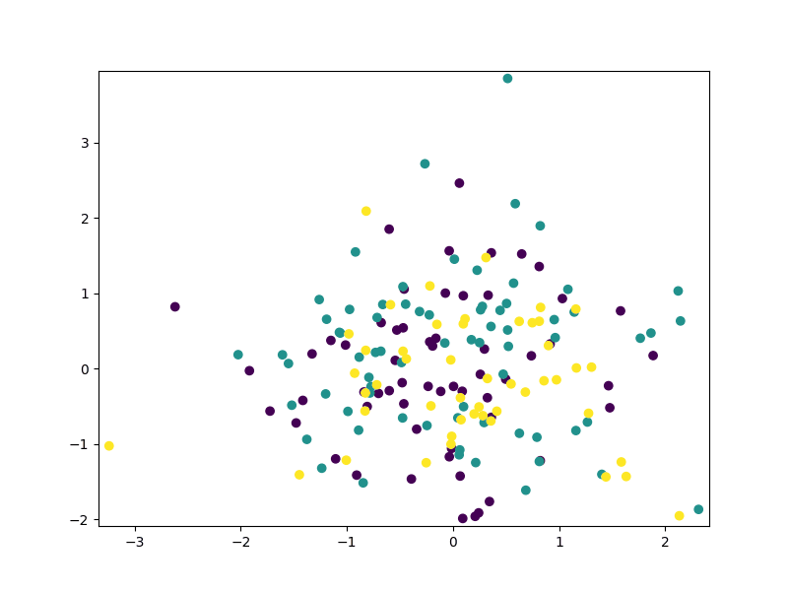
Iris Dataset
Wine Dataset

Slide 15
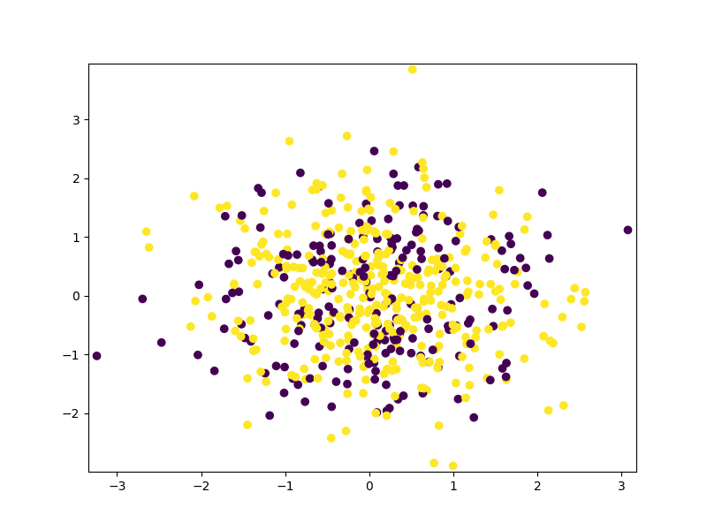
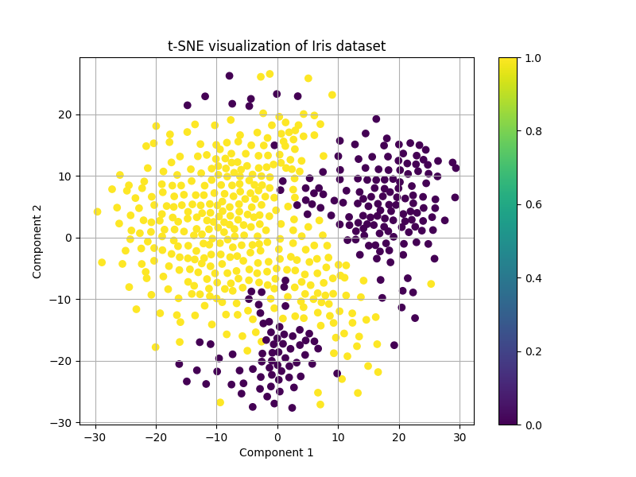
Breast Cancer Dataset

Slide 16
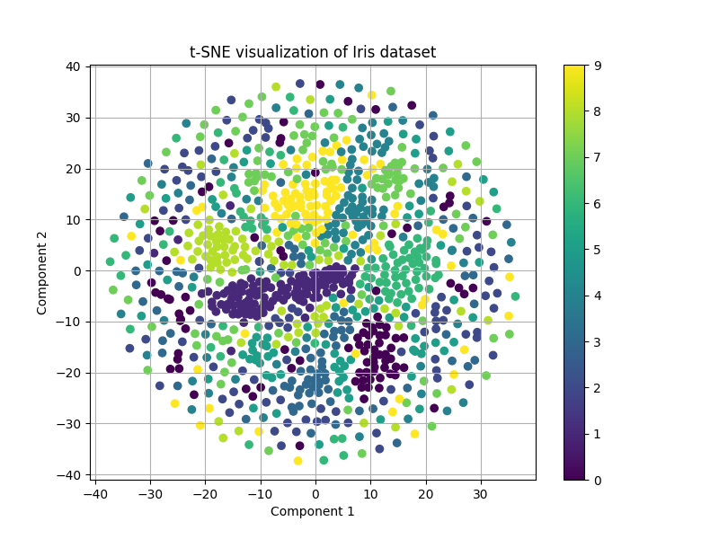
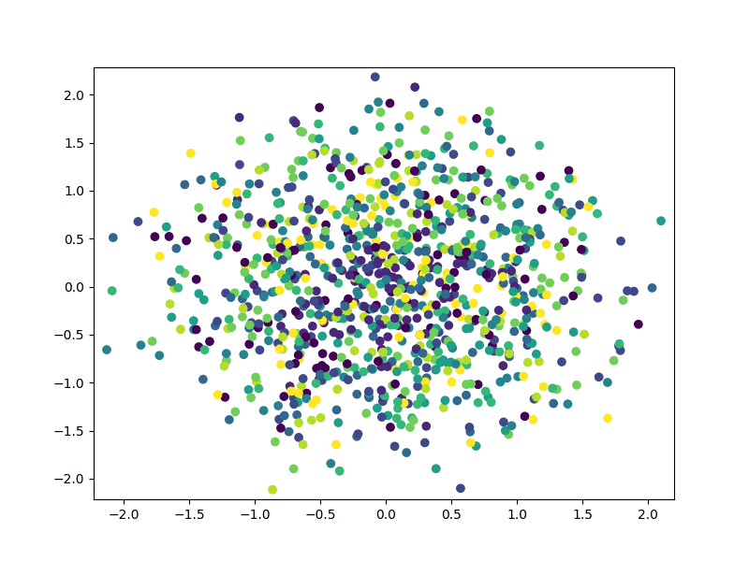
Mnist Dataset

Slide 17
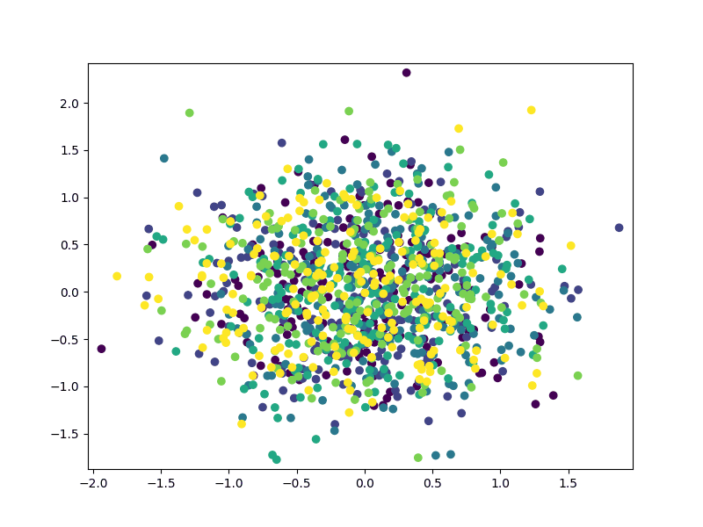
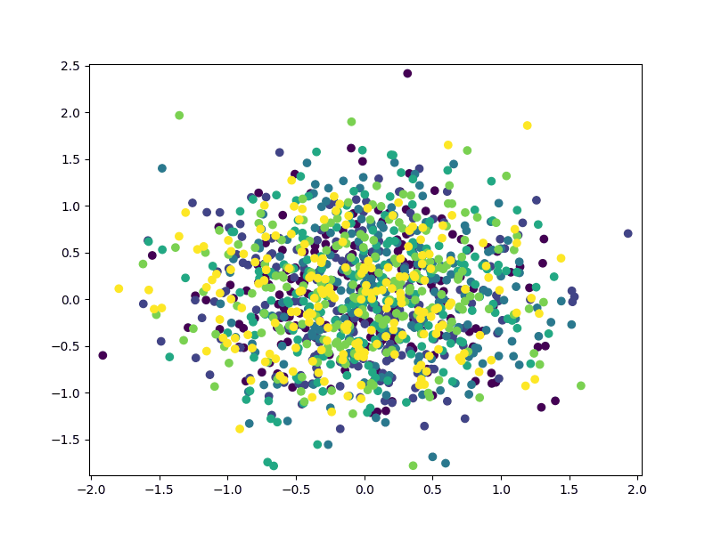
Synthetically Generated Dataset
Entangled Ring’s Dataset
Half Moons Dataset

Slide 18
Improvement through convex hulls - Custom metrics

Slide 19
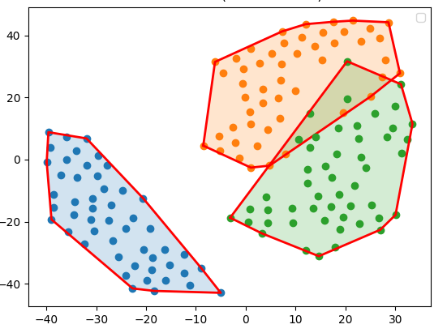
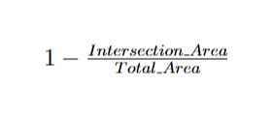
Iris Dataset Convex Hull Metric
Custom Evaluation Metric Based on Convex hulls
Score:
0.94
Compute Convex Hulls using graham scan.
Compute the intersection polygons
Calculate the Score:

Slide 20
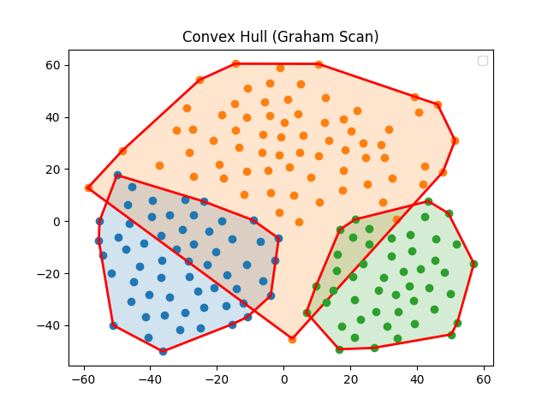
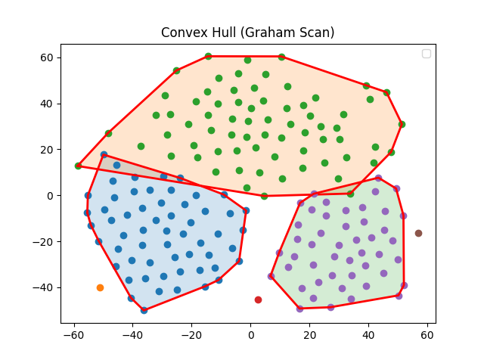
Wine Dataset
Removing Outliers
Score:
0.862
Define Tolerance: ex- 2%
Remove Outliers
Score:
0.99

Slide 21
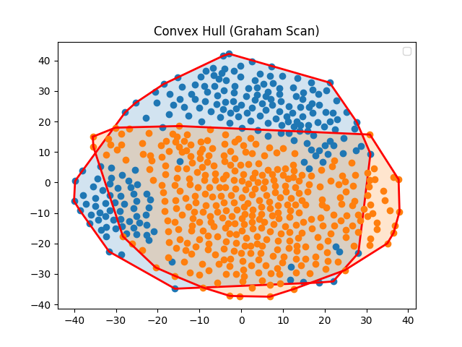
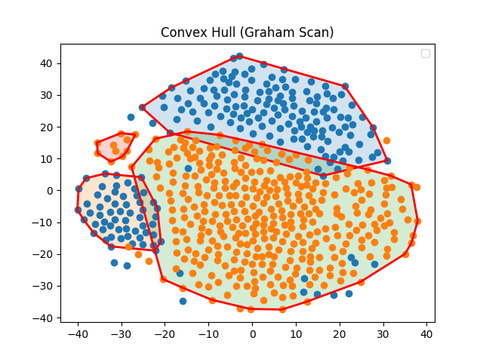
Breast Cancer Dataset
Handling Island Clusters
Score:
0.606
Run DbScan for each Cluster label
Split to Sub-clusters
Calculate Score
Time Complexity: O(nlogn)
Score:
0.952

Slide 22
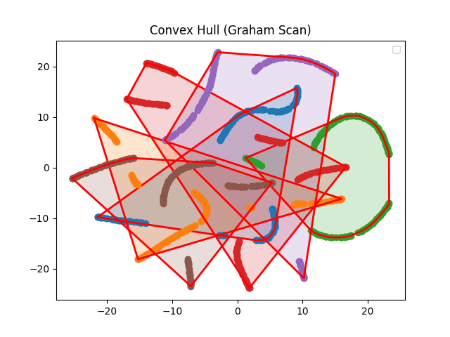





Synthetic Datasets
Half-Moons
Swiss-Roll
Entangled-Rings
Updated
Metric

Slide 23

Mnist Digits (Tough dataset to Cluster)

Slide 24
Scores Compared to Existing Evaluation Metrics
Dataset | Custom Metric (Ranges: -C to 1) | Silhouette Score (Ranges -1 to 1) Higher Value Better | Davies Bouldin Index (Ranges 0 to infinity) Lower value Better
Iris Flower Dataset | 0.94 | 0.42 | 0.89
Wine Dataset | 0.9824 | 0.438 | 0.787
Breast Cancer Dataset | 0.952 | 0.226 | 2.028
Entangled Rings | 0.98 | -0.0123 | 9.2485
Half Moons | 1.0 | 0.0309 | 10.909
Swiss Roll | 0.712 | -0.0529 | 14.619
Mnist Digits Dataset | 0.712 | -0.0529 | 14.6199

Slide 25


Issues with this approach

Slide 26
Application - Custom metrics

Slide 27

Dynamic TSNE
Dataset | Iterations (2000) | Score (0.9, 20) | Time (std, dyn) sec
Iris | 120 | 0.9911 | 2.63, 0.20
Wine | 20 | 0.9302 | 3.43, 0.08
Breast Cancer | 1140 | 0.9000 | 51.56, 34.03
Entangled Rings | 1060 | 0.9004 | 221.94, 129.43
Half Moons | 160 | 0.9001 | 209.66, 22.51
Swiss Roll | 760 | 0.9169 | 170.54, 73.92
Mnist Digits | 1999 | 0.6253 | 154.02, 177.10
Dynamic t-SNE adaptively stops when cluster quality (via convex hull + DBSCAN) meets target_score.
Periodically checks clustering score every check_interval iterations.
Removes outliers (tolerance_percentage) before scoring.

Slide 28






Iris Dataset
Entangled Rings Dataset
Wine Dataset
Half Moons Dataset
Breast Cancer Dataset
Swiss Roll Dataset

Slide 29
Future Scope
Optimize the custom-metric calculations.
Test out better and reliable alternatives to dbscan sub-clustering.
Concrete Experimentation/Proof that the custom metric is a reliable parameter.
Use the metric to optimize TSNE runtimes.

Slide 30
References
https://towardsdatascience.com/t-sne-behind-the-math-4d213b9ebab8/
https://en.wikipedia.org/wiki/T-distributed_stochastic_neighbor_embedding
https://en.wikipedia.org/wiki/Silhouette_(clustering)
https://en.wikipedia.org/wiki/Davies%E2%80%93Bouldin_index
https://towardsdatascience.com/three-versions-of-k-means-cf939b65f4ea/
Notes from class

Slide 31
Thank You

